Slide 1
Scaling Memcache at Facebook
Notes:
https://www.cs.princeton.edu/~wlloyd/classes/599s15/slides/23_memcache.pdf
https://www.usenix.org/sites/default/files/conference/protected-files/nishtala_nsdi13_slides.pdf

Slide 2
Agenda
Background
memcache Design Goals
memcache as a Query Cache
Congestion Control
Reducing Load
Failure Recovery
Georedundancy
Single-Server Performance

Slide 3
Terminology
memcached
memcache
Incast congestion

Slide 4
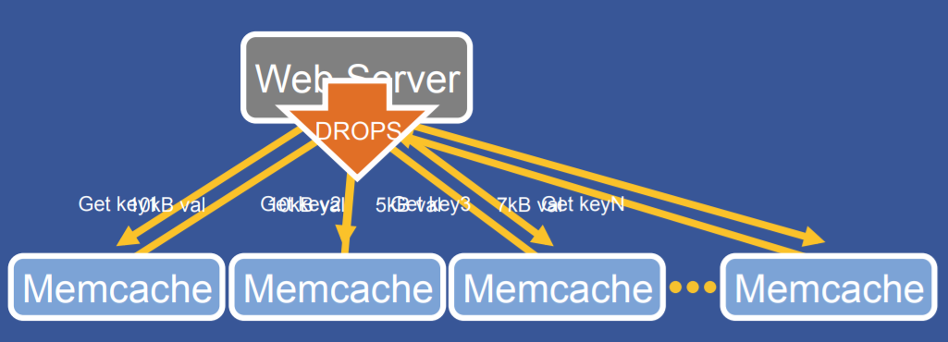
Incast Congestion
“Many simultaneous responses overwhelm a shared networking resource”

Slide 5
memcached
Basic building block for a distributed key-value store at Facebook
Trillions of items
Billions of requests / second
Network-attached in-memory hash table
Supports LRU based eviction
set, get, delete, nothing else
Single-threaded*
Persistence not a goal

Slide 6
memcache
Problem: too many requests
Solution: caching!
Read-heavy (2 orders of magnitude) more reads than writes
...but memcached is for a single server
...must be scaled
Persistence not a goal

Slide 7
memcache Design Requirements
Support a very heavy read load
Over 1 billion reads / second
Insulate backend services from high read rates
Geographically distributed
Support a constantly evolving product
System must be flexible enough to support a variety of use cases
Support rapid deployment of new features
Persistence not a goal
...but support mechanisms to refill after updates

Slide 8
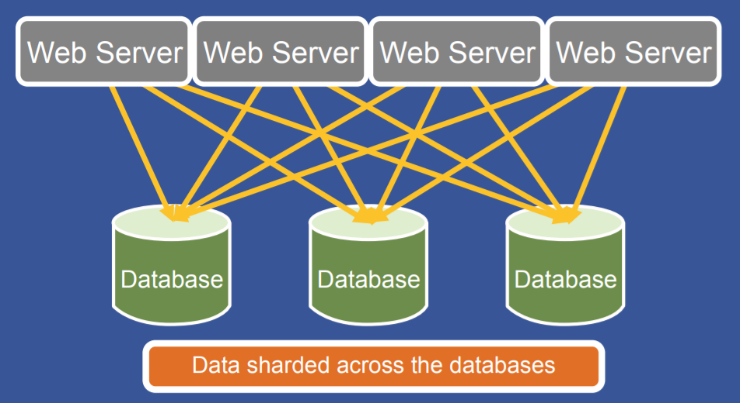
Pre-memcache

Slide 9
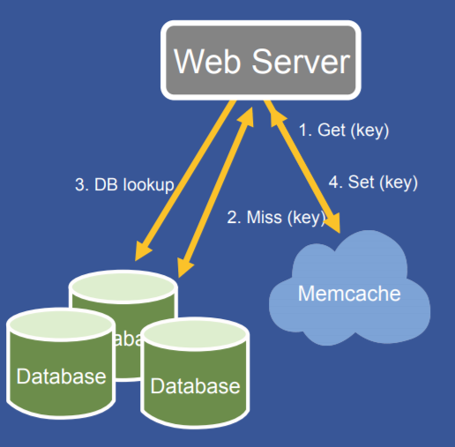
memcache as a Query Cache: Reads
Two orders of magnitude more reads than writes
Solution: deploy a few memcache hosts to handle the read capacity
Demand-filled look-aside cache
Common case is data is available in the cache
Over UDP

Slide 10
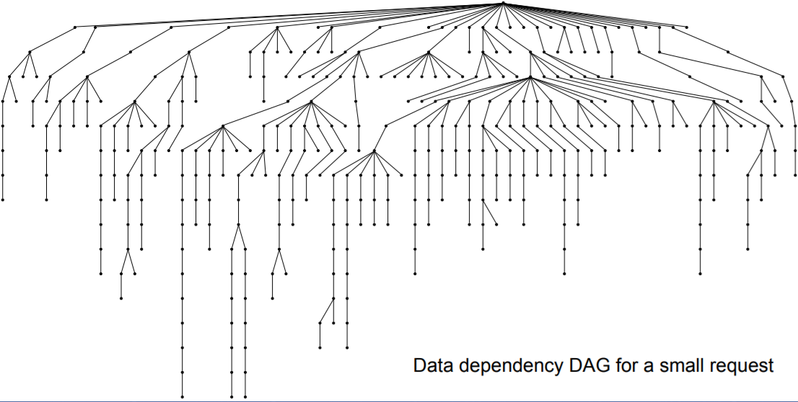
memcache as a Query Cache: Reads
High fanout and multiple rounds of data fetching

Slide 11
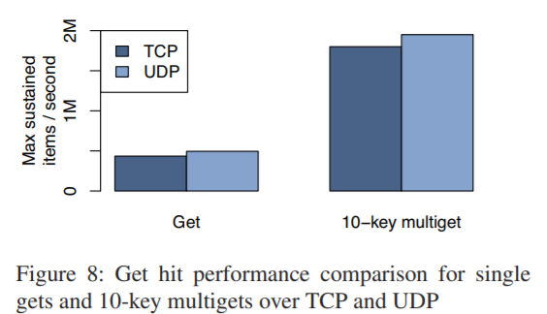
memcache as a Query Cache: Reads over UDP

Slide 12
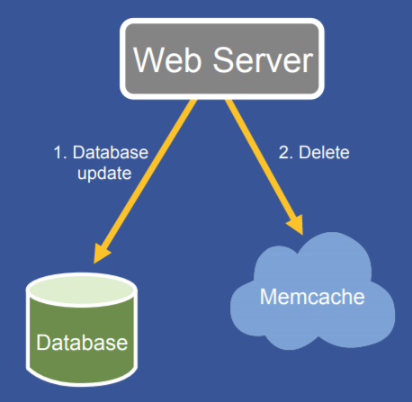
memcache as a Query Cache: Updates
memcache needs to be invalidated after DB write
Prefer deletes to sets
Idempotent
Demand-filled
Up to web application to specify which keys to invalidate after database update
Over TCP

Slide 13
memcache as a Query Cache: Invalidation
“Up to web application to specify which keys to invalidate after database update”
mcsqueal daemon deployed on every database
Inspects the SQL statements that its database commits (tails commit log)
Extracts deletes
Broadcasts deletes to its associated memcache deployment
Allows caches to be resynchronized in the event of a problem (just replay)
Most (96%) of updates are not actually deletes
Too much network traffic

Slide 14
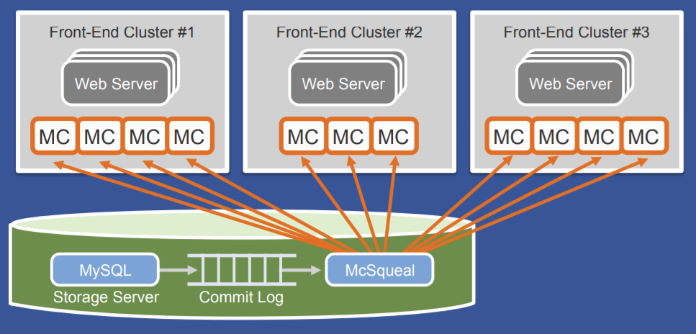
memcache as a Query Cache: Invalidation

Slide 15
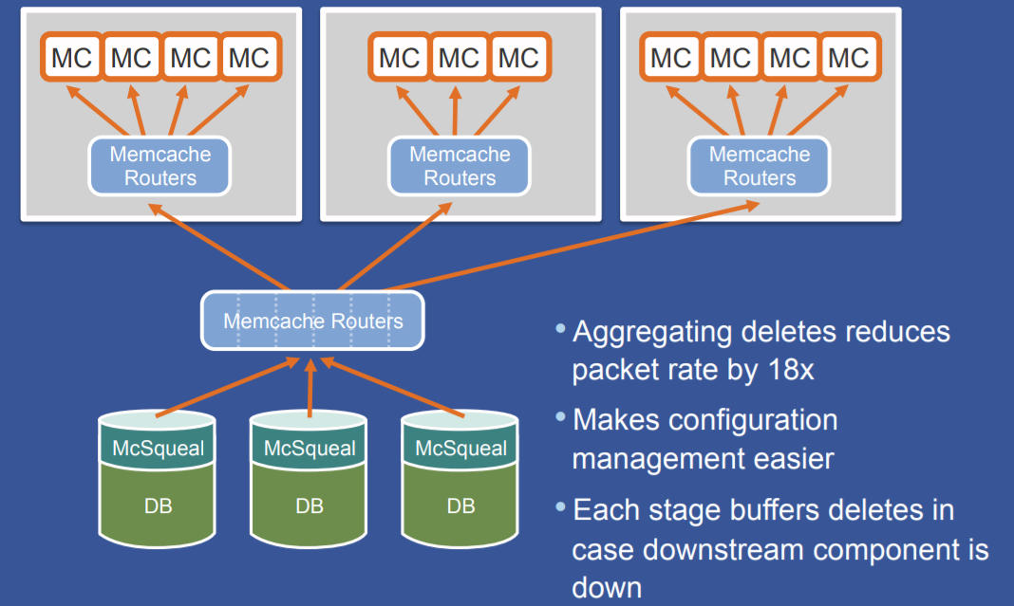
memcache as a Query Cache: Invalidation

Slide 16
memcache as a Query Cache: Invalidation
Still a lot of packets
Can reduce further by having mcsqueal batch deletes into fewer packets
18x improvement in the median number of deletes per packet

Slide 17
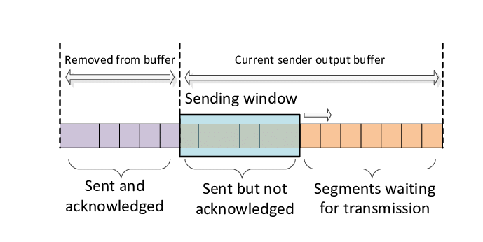
Congestion Control
Reads use UDP, not TCP
UDP has no congestion control
...but we do want congestion control
...just not the overhead of a TCP connection
Solution: reimplement TCP-like sliding window over UDP

Slide 18
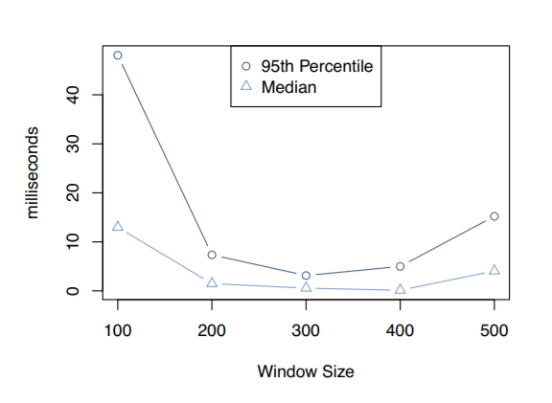
Congestion Control

Slide 19
Reducing Load with Leases
Solves “stale sets” and “thundering herds” problems with leases
Stale sets: can happen when concurrent updates get reordered
A sends foo=1 to memcache
B sends foo=2 to memcache
foo=2 arrives at memcache
foo=1 arrives at memcache
memcache thinks foo=1
Thundering herds: heavy read/write traffic, more requests hitting slow path

Slide 20
Reducing Load with Leases
memcached instance gives a lease to a client on cache miss
64-bit token bound to the specific key originally requested
Write may fail if the token has been invalidated by a delete for that key
Only hand out one lease every 10 seconds (thundering herds)
Notify concurrent readers to “try again soon”
Writes are usually fast (few milliseconds)

Slide 21
Reducing Load with Leases: Analysis
Seems to work well in practice
On “a set of keys particularly susceptible to thundering herds for on week”:
17K/s peak database query rate without leases
1.3K/s with leases

Slide 22
Reducing Load by Returning Stale Values
Some applications are fine with slightly stale values
On delete, key-value is set aside for a short time in a separate structure
Applications can obtain leases on this stale data
Make forward progress without waiting on database
Data evicted a short time later

Slide 23
Reducing Load by Pooling by Churn
memcached has LRU policy
memcache is not application-specific; serves many
Mixing low-churn, expensive-to-reconstruct keys with high-churn, inexpensive keys is bad
End up evicting the expensive keys before the inexpensive ones
Main idea: split up items by churn characteristics
Default “wildcard” pool
Create pool for “hot” keys and “cold” keys

Slide 24
Reducing Load by Replicating
memcached is largely network-bound
Small difference between retrieving 1 keys per request and retrieving 100
One server holding 100 keys can respond to 500K reqs/s
Each request asks for all 100
Splitting the server into two, 50/50
Each server still can only respond to 500K reqs/s
Not actually faster
Solution: replicate the entire server, if:
Multi-key requests are common;
Entire dataset can fit on a single server; and
Request rate is too high for a single server
...must now deliver invalidations to all replicas

Slide 25
Handling Failures
Two major scales:
A small number of hosts are inaccessible due to a network or server failure
A widespread outage affects a significant percentage of cluster servers
Large outages require manual intervention
Can still try to recover from small ones

Slide 26
Handling Failures
Introduce idle “Gutter” machines in cluster (approx. 1%)
Being idle is important to prevent cascading failures
When memcached client times out on get request, assumes server failure
Retries request on Gutter:
If this also misses, client will hit DB for data and insert it into Gutter
Lots of clients will time out and hit Gutter (better than DB)
Hack: invalidation is hard, so instead have Gutter entries expire quickly
Stale data, but at least system is up

Slide 27
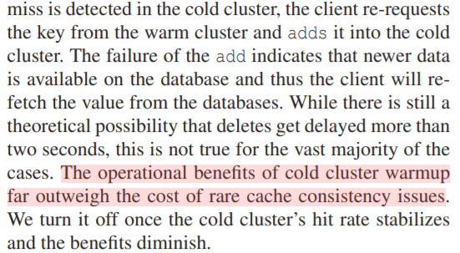
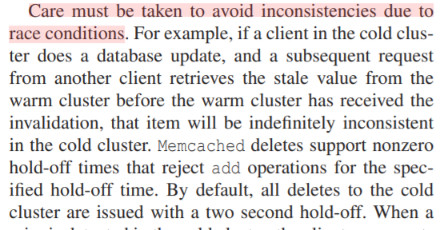
Cold Cluster Warmup
Problem: bringing up a cluster is slow, lots of DB reads
Solution: read from an already-running (“warm”) cluster instead
Possible race conditions, 4.3 Cold Cluster Warmup

Slide 28
Cross-Region Replication
Necessary for data durability and availability
One region holds master database, others hold replicas
Synced via MyQL replication
Plays well with mcsqueal
Avoids race condition where invalidation arrives before data has been replicated

Slide 29
Cross-Region Replication
Writes from a master region are easy to handle
Don't need to do anything special
mcsqueal will handle invalidation in each region

Slide 30
Cross-Region Replication
Writes from non-master region are harder
If replication lag is sufficient, user can make an update, refresh their page, and not see their changes
Cache refill should only be allowed from replica database once it’s caught up
“Remote marker” mechanism: tag a key in local replica as being possibly-stale

Slide 31
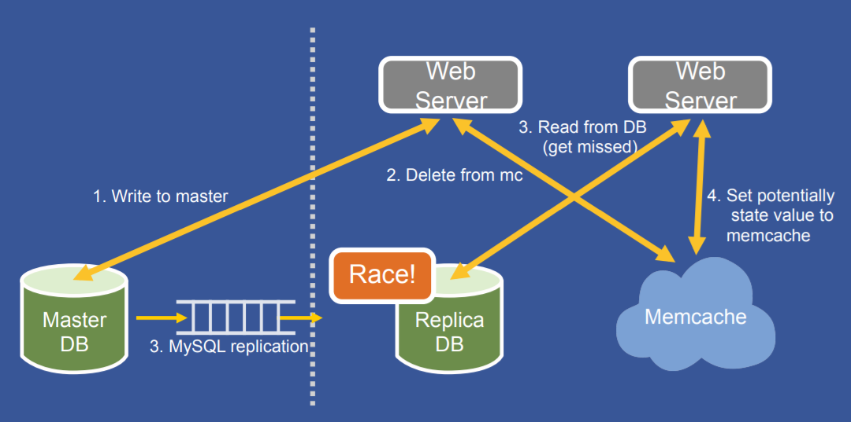
Cross-Region Replication

Slide 32
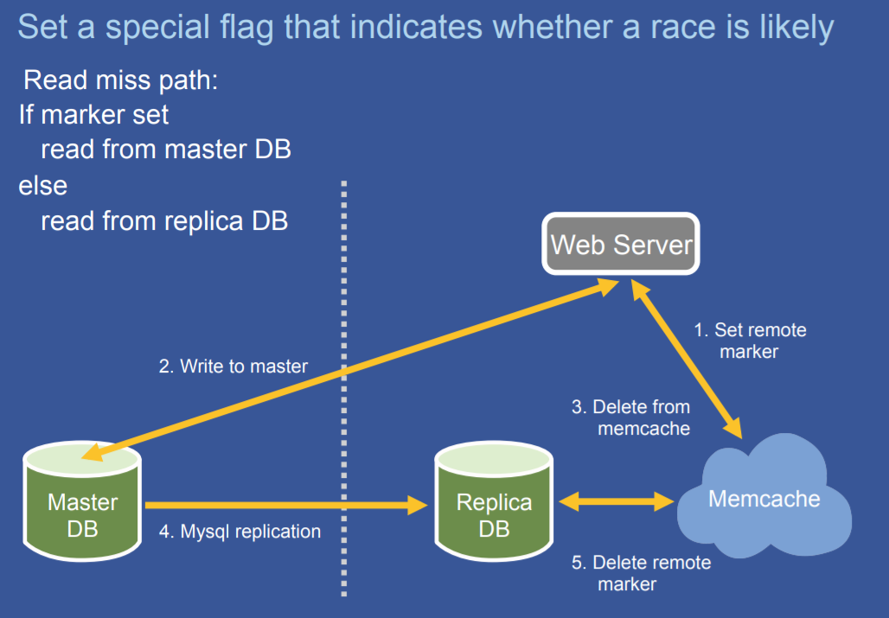
Cross-Region Replication

Slide 33
Single-Server Performance Improvements
Communication is all-to-all, so a single server can become a bottleneck
Make memcached multi-threaded (upstreamed)
Protected by one big global lock
Experimented with finer-grained locks
Allow internal hashtable to automatically expand (upstreamed)
Give each thread its own UDP port to avoid contention (not upstreamed)

Slide 34
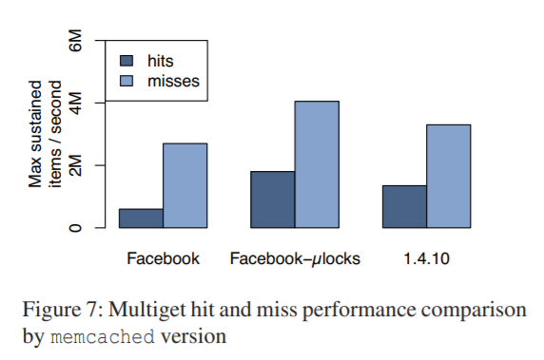
Single-Server Performance Improvements

Slide 35
Miscellaneous
memcache stores its values in System V shared memory
Allows data to remain live across a software disruption
Otherwise, rolling takes a long time (“over 12 hours to upgrade a set”)
Adaptive slab allocator: periodically re-balance buckets based on usage
Transient item cache:
Short lived keys take a long time to get evicted from LRU
Put them in a bucketed-by-second linked list

Slide 36
Lessons Learned
(from NSDI presentation)
Push complexity into the client whenever possible
Operational efficiency is as important as performance
Separating cache and persistent store allows them to be scaled independently

